Slide 1

HOUSING PROJECT
DATA
SCIENCE
INTERNSHIP PROJECT

Slide 2

PROBLEM STATMENT
HOUSING
PROJECT

Slide 3

About The Project
A US-based housing company named Surprise Housing has decided to enter the Australian market. The company uses data analytics to purchase houses at a price below their actual values and flip them at a higher price. For the same purpose, the company has collected a data set from the sale of houses in Australia. The data is provided in the CSV file below.
The company is looking at prospective properties to buy houses to enter the market. You are required to build a model using Machine Learning in order to predict the actual value of the prospective properties and decide whether to invest in them or not. For this company wants to know:
Which variables are important to predict the price of variable?
How do these variables describe the price of the house?

Slide 4
About The Project
There are a total of 81 Columns present in the dataset.
Of which 80 columns are features and 1 column i.e., Saleprice.
The Dataset Contains 1168 entries.
There are two files used in this project: train.csv and test.csv .

Slide 5
EDA
HOUSING
PROJECT

Slide 6
Columns In Dataset
Column Names:
'Id', 'MSSubClass', 'MSZoning', 'LotFrontage', 'LotArea', 'Street', 'Alley', 'LotShape', 'LandContour', 'Utilities', 'LotConfig’, 'LandSlope', 'Neighborhood', 'Condition1', 'Condition2', 'BldgType’, 'HouseStyle', 'OverallQual', 'OverallCond', 'YearBuilt', 'YearRemodAdd’, 'RoofStyle', 'RoofMatl', 'Exterior1st', 'Exterior2nd', 'MasVnrType', 'MasVnrArea', 'ExterQual', 'ExterCond', 'Foundation', 'BsmtQual’, 'BsmtCond', 'BsmtExposure', 'BsmtFinType1', 'BsmtFinSF1’, 'BsmtFinType2', 'BsmtFinSF2', 'BsmtUnfSF', 'TotalBsmtSF', 'Heating','HeatingQC', 'CentralAir', 'Electrical', '1stFlrSF', '2ndFlrSF’, 'LowQualFinSF', 'GrLivArea', 'BsmtFullBath', 'BsmtHalfBath', 'FullBath’, 'HalfBath', 'BedroomAbvGr', 'KitchenAbvGr', 'KitchenQual’, 'TotRmsAbvGrd', 'Functional', 'Fireplaces', 'FireplaceQu', 'GarageType', 'GarageYrBlt', 'GarageFinish', 'GarageCars', 'GarageArea', 'GarageQual’, 'GarageCond', 'PavedDrive', 'WoodDeckSF', 'OpenPorchSF’, 'EnclosedPorch', '3SsnPorch', 'ScreenPorch', 'PoolArea', 'PoolQC’, 'Fence', 'MiscFeature', 'MiscVal', 'MoSold', 'YrSold', 'SaleType’, 'SaleCondition', 'SalePrice'

Slide 7
Columns With Null Values
MasVnrType 1161 non-null object
MasVnrArea 1161 non-null float64
BsmtQual 1138 non-null object
BsmtCond 1138 non-null object
BsmtExposure 1137 non-null object
BsmtFinType1 1138 non-null object
BsmtFinType2 1137 non-null object
GarageType 1104 non-null object
GarageYrBlt 1104 non-null float64
GarageFinish 1104 non-null object
GarageQual 1104 non-null object
GarageCond 1104 non-null object
GarageCond 1104 non-null
PoolQC 7 non-null object
Fence 237 non-null object
MiscFeature 44 non-null object
Alley 77 non-null object
FireplaceQu 617 non-null object
LotFrontage 954 non-null float64

Slide 8
Unique Values VS Feature Description
Below are a few feature columns as to how we compared them and filled null values.
Unique Values
Feature Descriptions
BsmtQual : ['TA’, 'Gd’ ,’Ex’, NA, 'Fa’]
BsmtCond : ['Gd’, 'TA’ ,'Fa’ ,NA, 'Po’]
BsmtExposure : ['Gd’, 'Av’, 'No’, ‘Mn’, NA]
BsmtFinType1 : ['ALQ’ ,'GLQ’, 'BLQ’, 'Unf’, 'Rec’ ,'LwQ’ ,NA]
BsmtFinType2 : ['Rec’ ,'Unf’ ,'BLQ’ ,'GLQ’, 'ALQ’ ,NA, 'LwQ']
Evaluates the height of the basement: Excellent (100+ inches), Good (90-99 inches), Typical (80-89 inches), Fair (70-79 inches), Poor (<70 inches, No Basement.
Evaluates the general condition of the basement: Excellent, Good, Typical-slight dampness allowed, Fair - dampness or some cracking or settling, Poor - Severe cracking, settling, or wetness, No Basement.
Refers to walkout or garden level walls: Good Exposure, Average Exposure, Minimum Exposure, No Exposure, No Basement.
Rating of basement finished area: Good Living Quarters, Average Living Quarters, Below Average Living Quarters, Average Rec Room, Low Quality, Unfinished, No Basement.
Rating of basement finished area (if multiple types): Good Living Quarters, Average Living Quarters, Below Average Living Quarters, Average Rec Room, Low Quality, Unfinished, No Basement

Slide 9
Filling Null Values
After studying the features description, we can understand that Null values were also another classification type, for example in Data Description for ‘BsmtQual’ feature NA means ‘No Basement’, Hence we can fill values in this way for classification type features, and for linear type we can store as Mean of its own feature.
df["BsmtQual"].fillna('No Basement', inplace = True)
df["BsmtCond"].fillna('No Basement', inplace = True)
df["BsmtExposure"].fillna('No Basement', inplace = True)
df["BsmtFinType1"].fillna('No Basement', inplace = True)
df["BsmtFinType2"].fillna('No Basement', inplace = True)
df["GarageType"].fillna('No Garage', inplace = True)
df["GarageFinish"].fillna('No Garage', inplace = True)
df["GarageQual"].fillna('No Garage', inplace = True)

Slide 10
Filling Null Values Conti…
df["GarageCond"].fillna('No Garage', inplace = True)
df["MasVnrArea"].fillna(np.mean(df["MasVnrArea"]), inplace = True)
df["GarageYrBlt"].fillna(np.mean(df["GarageYrBlt"]), inplace = True)
df["PoolQC"].fillna("No Pool", inplace = True)
df["Fence"].fillna("No Fence", inplace = True)
df["MiscFeature"].fillna("None", inplace = True)
df["Alley"].fillna("No Alley access", inplace = True)
df["FireplaceQu"].fillna("No Fireplace", inplace = True)

Slide 11
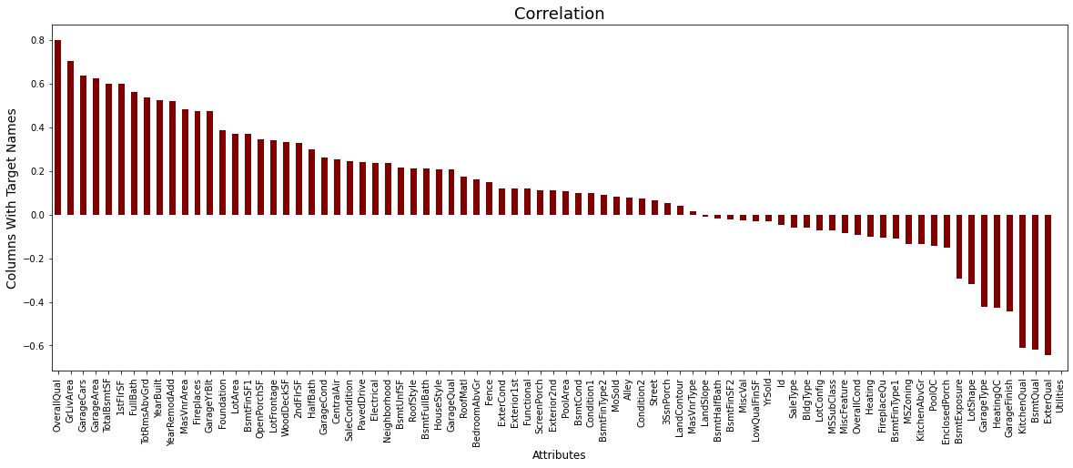
Correlation With Sales Price

Slide 12

Correlation
Continue..
In the previous slide we can see that there are almost 40% of the features having a negative correlation with ‘Sales Price’ with ‘Utilities’ having the highest negative correlation.
There is a majority of more than 60% of the features having positive correlation with ‘Sales Price’ with ‘OverallQual’ having the highest positive correlation.
Add a footer
12

Slide 13
MODEL SELECTION & MODEL SAVING
HOUSING
PROJECT

Slide 14
MODEL SELECTION
MODEL NAME | ACCURACY SCORE
LINEAR REGRESSION | 87.5%
K-NEIGHBORS REGRESSOR | 83.3%
DECISIONTREE REGRESSOR | 83.2%
RANDOM FOREST REGRESSOR | 92%
From the above table the model with the best accuracy score is RandomForest Regressor, hence we can select it as our model.

Slide 15
HYPER TUNING
Using Grid Search CV we will find the best Parameters to tune our model.
CODE:
from sklearn.model_selection import GridSearchCV
parameters={'criterion':["squared_error", "absolute_error", "poisson"],
'max_depth':range(1,10,2),
'max_features':["auto", "sqrt", "log2"],
'ccp_alpha':[0.0001,0.001,0.01,0.1,1,10]}
clf=GridSearchCV(rf,parameters)
clf.fit(features_train,target_train)
print(clf.best_params_)
OUTPUT:
{'ccp_alpha': 0.1, 'criterion': 'squared_error', 'max_depth': 9, 'max_features': 'sqrt'}

Slide 16
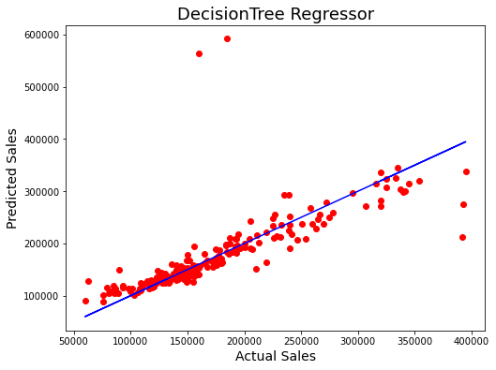
AUC ROC
Model Curve
From this curve we can see that the line is more slanted towards the X-axis.
There are many red dots close to the line hence we can conclude that this is a good model.
Model is later saved as:
joblib.dump(rf,'Housing Project Model.pkl')

Slide 17
THANK YOU
DATA
SCIENCE
MUFID SHAIKH

